Slide 1

Dhiraj Sharma
Data Analysis for Bike Rentals
Insights from Nexthike Motorbike Rentals

Slide 2


Project Overview
1
Total Rentals
58,304 analyzed
2
Weekday vs. Weekend
41,733 Weekday | 16,571 Weekend
3
Peak Demand
Occurs around 5 PM
4
Weather Impact
Clear highest, Heavy Rain lowest

Slide 3
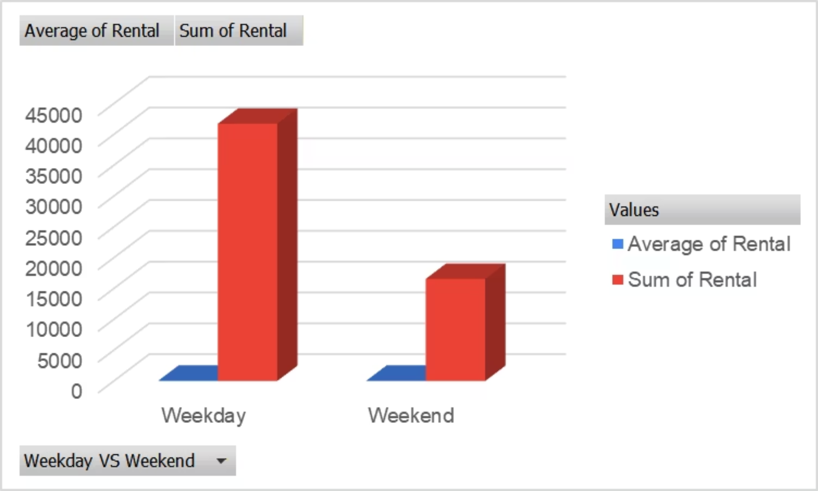

Key Insights
Higher Weekday Rentals
Consistent Average
Business Opportunity
Significantly more than weekends.
Average rental also higher on weekdays.
Focus fleet on weekdays.

Slide 4
Hourly Trend: User Types
Commute Peaks
Registered Users Drive Demand
Low Demand
Morning & evening.
Late night/early morning.
Major contribution.

Slide 5
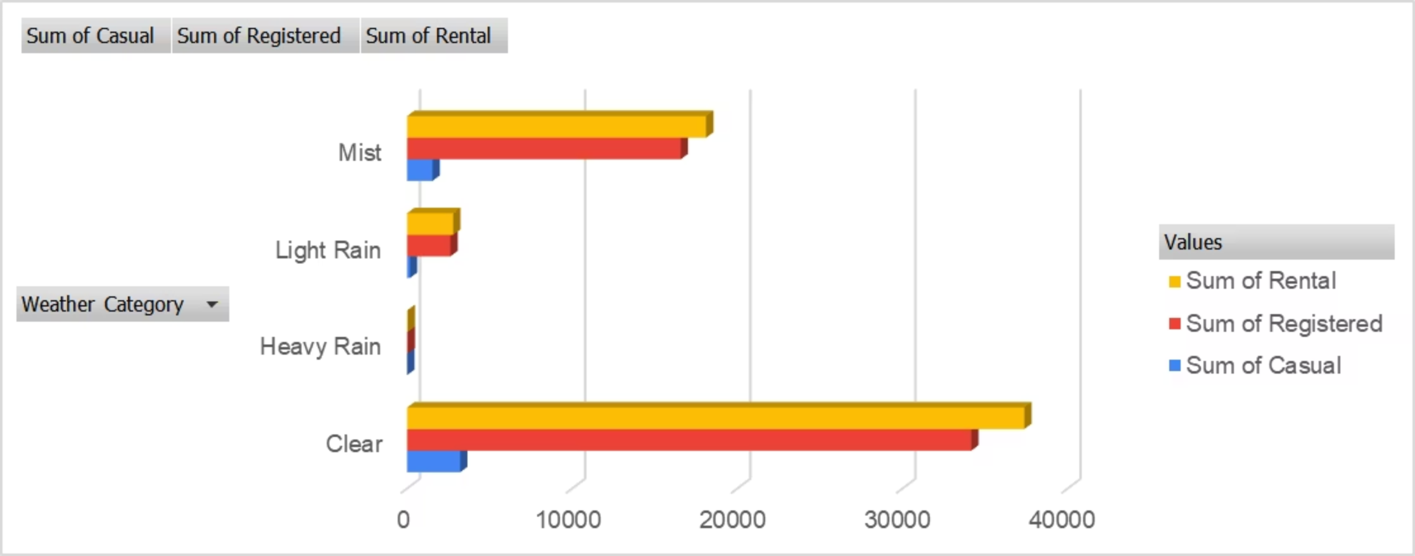
Weather Category Impact
Clear Weather
Mist Conditions
Rain Impact
Highest rentals.
Strong demand persists.
Sharp drop in casual rentals.

Slide 6
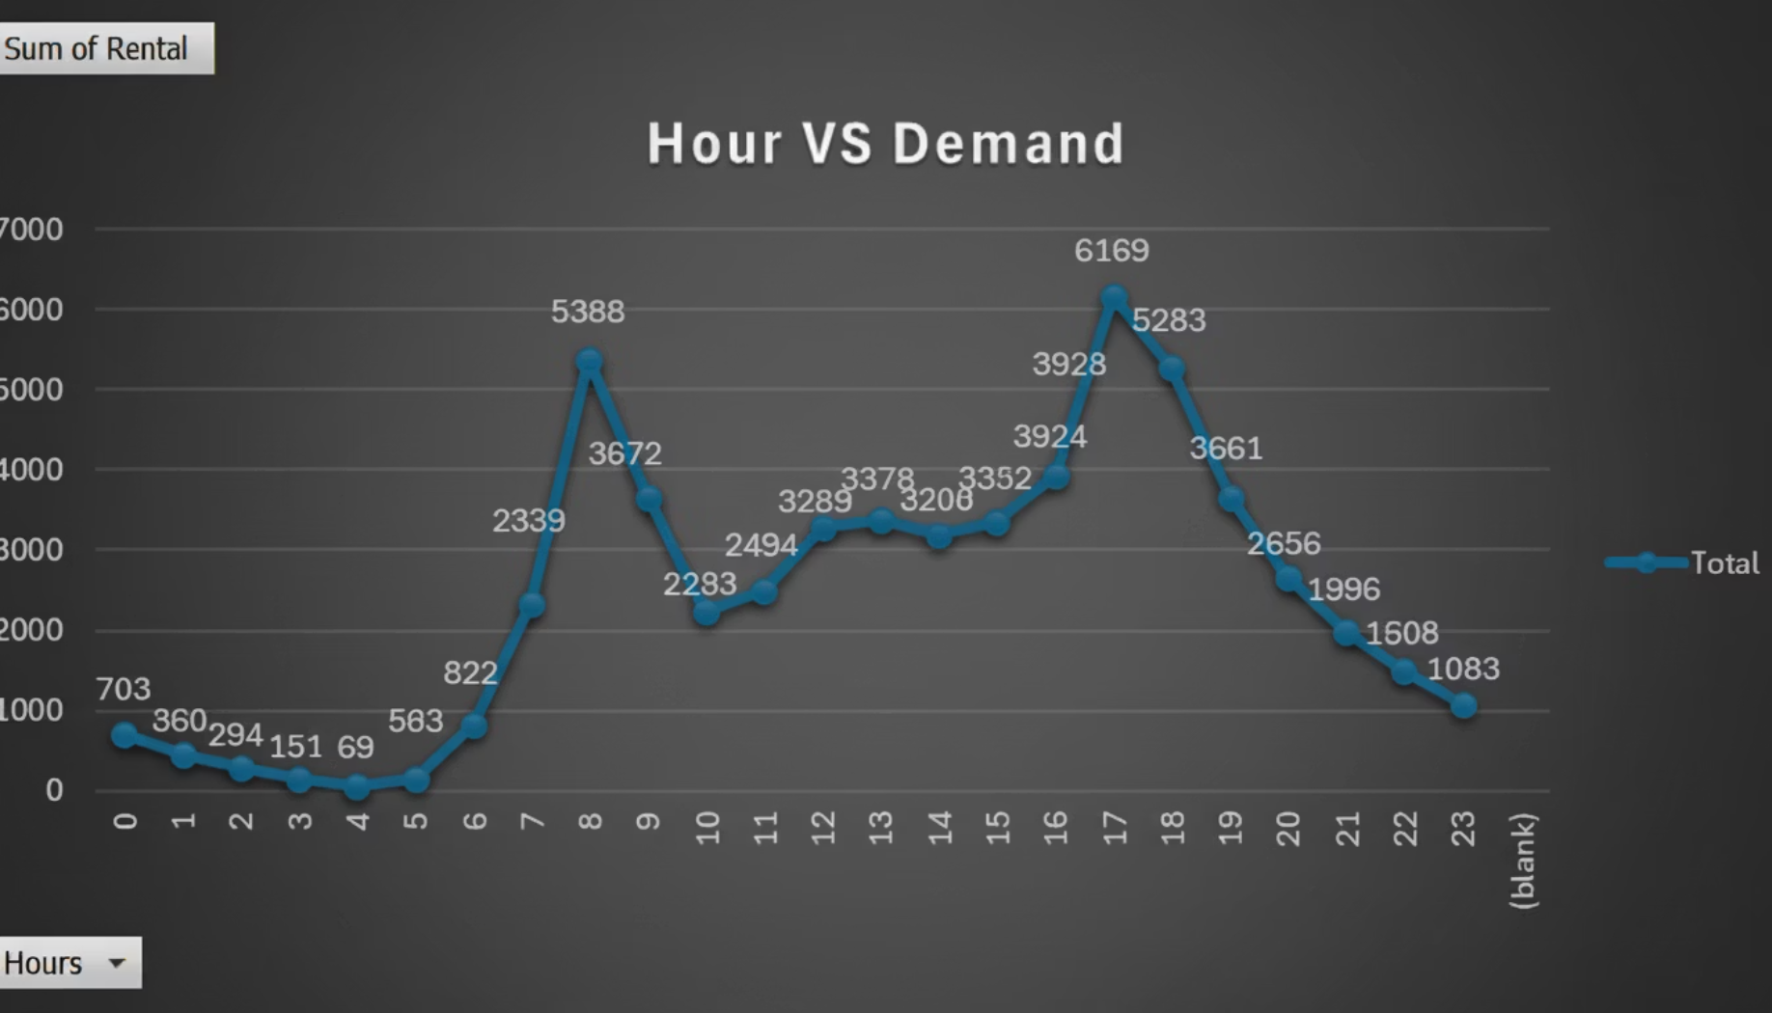
Hour vs. Total Demand
Peak: 17:00 (5 PM)
Morning Rise after 7 AM
Evening Surge
Maintenance in Low Hours

Slide 7
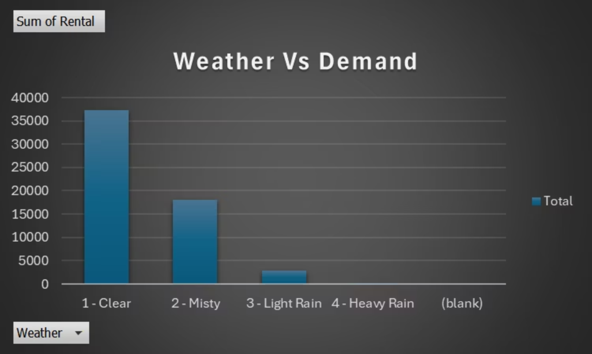
Weather vs. Total Demand
Clear Weather Dominates
Misty Weather
Heavy Rain
Highest rentals.
Second highest contributor.
Minimal demand; plan promotions.

Slide 8
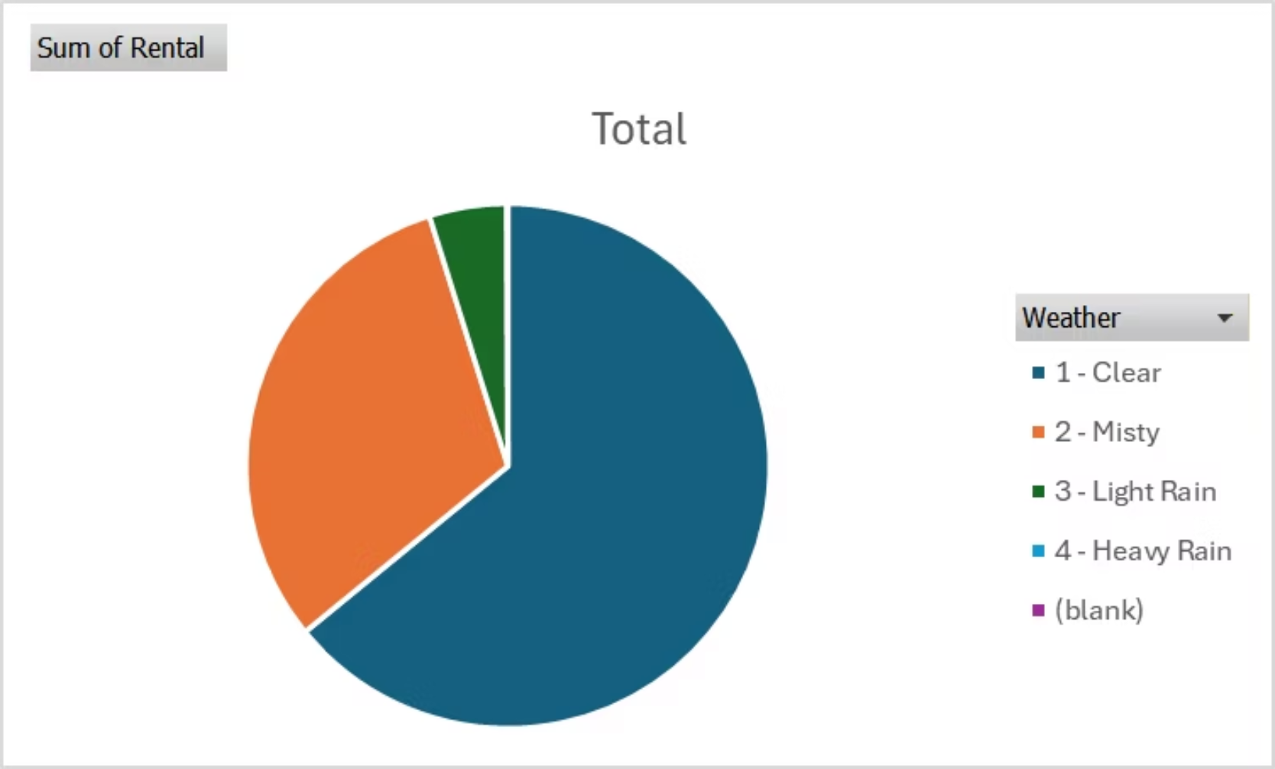






Weather Share
Misty Weather
Second biggest share.
Clear Weather
Largest rental share.
Rain Categories
Small portion of total demand.

Slide 9
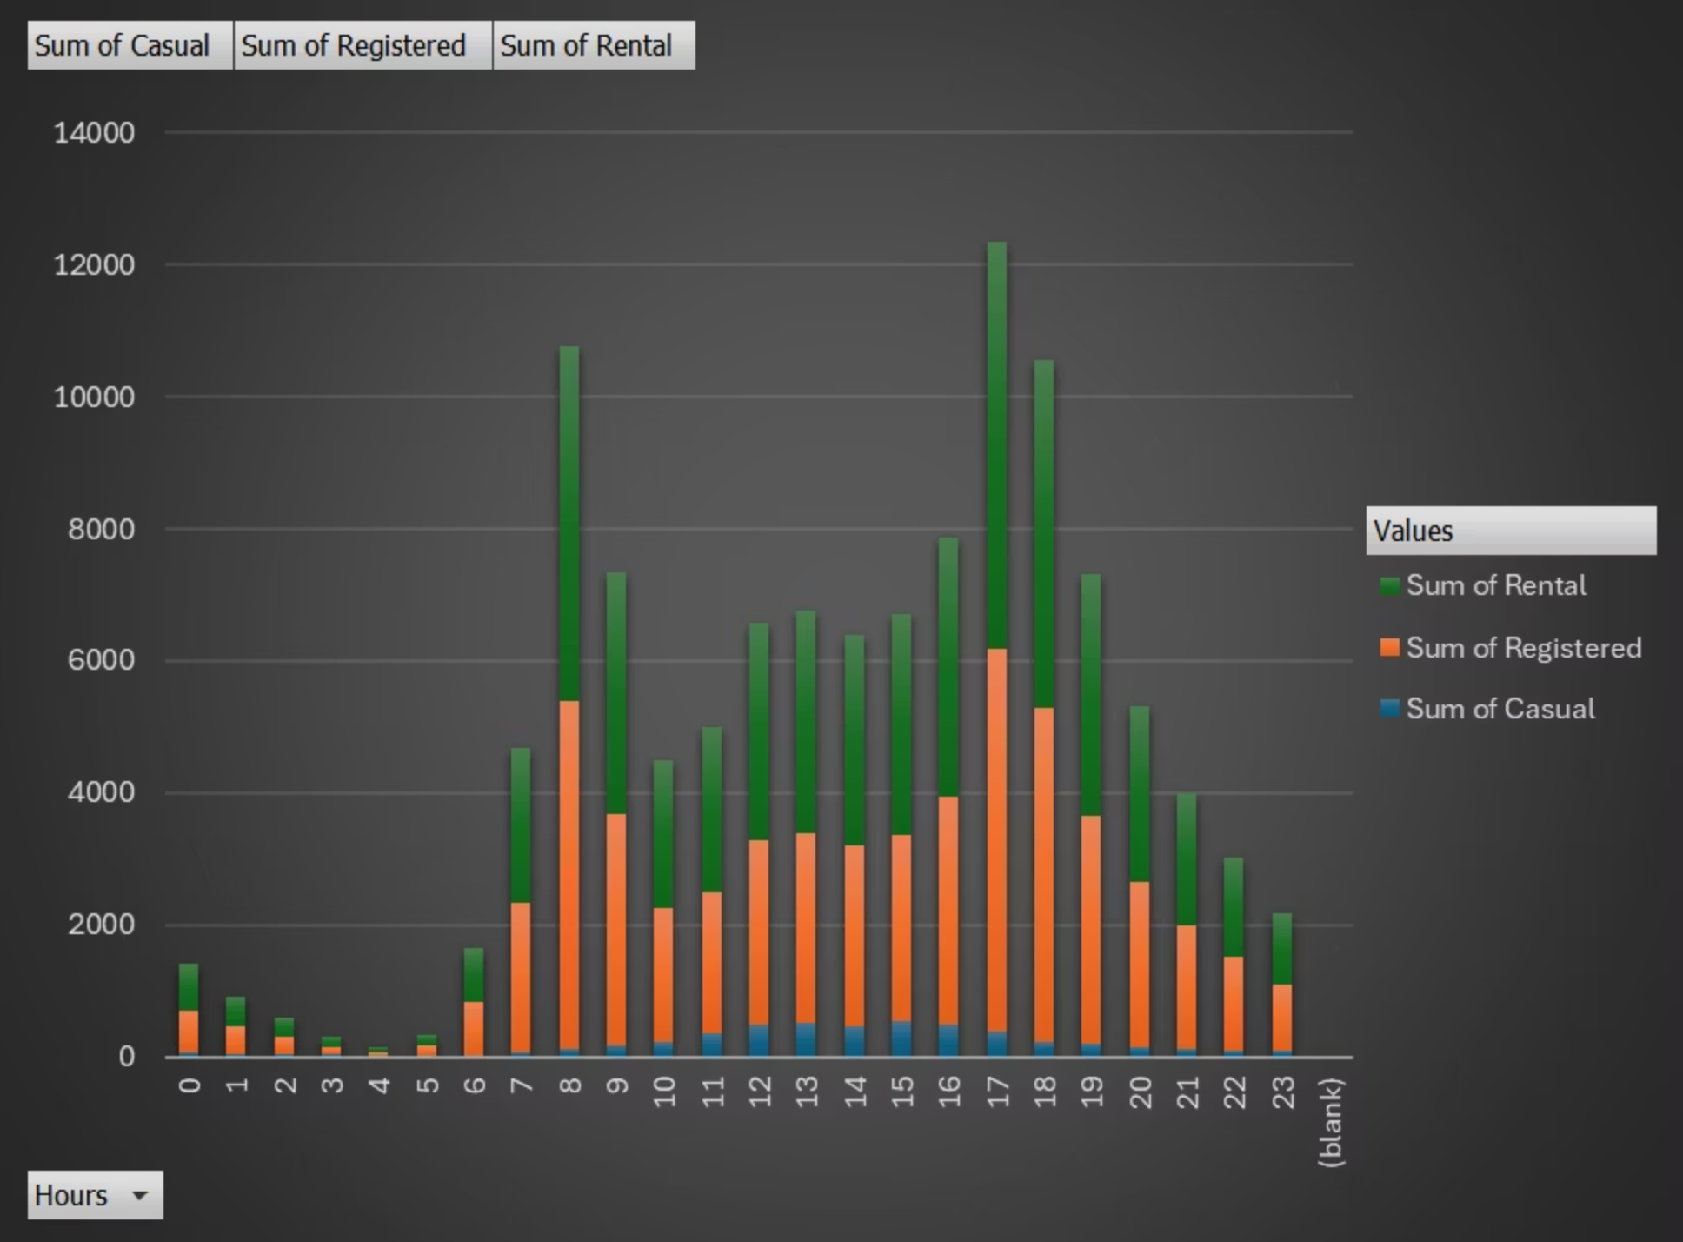


Hourly Distribution: Stacked Users
Registered Demand
Casual Usage
Evening Peak
Drives overall rental pattern.
Relatively smaller across hours.
Strongest period for total rentals.

Slide 10
Statistical Insights
Total Rentals
Weekday vs Weekend
Avg Rental / Record
58,304
41,733 | 16,571
58.3
Total rentals in dataset
Weekday | Weekend rentals
Average rental value
Demand Variability
Temp vs Rental
Humidity vs Rental
51.0
0.23
-0.25
Std deviation of rentals
Positive relationship
Negative relationship
Note: Correlation values help understand how weather conditions impact bike rental demand.

Slide 11





Recommendations
Increase Supply
During peak commute hours (8 AM, 5-6 PM).
Weather-Based Pricing
Promotions during Mist & Light Rain days.
Focus Loyalty
Campaigns on Registered users.
Schedule Servicing
During low-demand hours (midnight-5 AM).

